Slide 1


Steven Morgan
5/23/2024

Slide 2

Outline
Executive Summary
Introduction
Methodology
Results
Conclusion
Appendix

Slide 3
Executive Summary
Summary of methodologies
Summary of all results

Slide 4
Introduction
Spaceflight is expensive, With the improvements of landing and reusing the first stage of a rocket we can make spaceflight cheaper and safer. Cheaper flights will increase our ability to colonize other planets, Mine asteroids and make discoveries about our universe.
The problem with reuse is that there is a rate of failure that we need to predict and reduce. This requires us to have a firm and thorough understanding of how our rockets fail. We will address this by analyzing SpaceX launches and build a model to predict success and failure of the first stage landing.

Slide 5

Section 1

Slide 6
Methodology
Executive Summary
Data collection methodology:
Describe how data was collected
Perform data wrangling
Describe how data was processed
Perform exploratory data analysis (EDA) using visualization and SQL
Perform interactive visual analytics using Folium and Plotly Dash
Perform predictive analysis using classification models
How to build, tune, evaluate classification models

Slide 7
Data Collection
The data collection was done in two ways. First the SpaceX API was used to download the launch data. This gives us data from SpaceX themselves, the data set has 17 columns. Second is the data scraped from the wiki page on SpaceX, Using the BeautifulSoup library to process the html we can extract the table we need with launch data.
You need to present your data collection process use key phrases and flowcharts

Slide 8
Data Collection – SpaceX API
Present your data collection with SpaceX REST calls using key phrases and flowcharts
Data columns: FlightNumber, Date, BoosterVersion, PayloadMass, Orbit, LaunchSite, Outcome, Flights, GridFins, Reused, Legs, LandingPad, Block, ReusedCount, Serial, Longitude, Latitude
https://github.com/bobthebaka/DS-Capstone/blob/main/jupyter-labs-spacex-data-collection-api.ipynb
Place your flowchart of SpaceX API calls here

Slide 9
Data Collection - Scraping
Present your web scraping process using key phrases and flowcharts
https://github.com/bobthebaka/DS-Capstone/blob/main/jupyter-labs-webscraping.ipynb
Place your flowchart of web scraping here

Slide 10
Data Wrangling
Describe how data were processed
You need to present your data wrangling process using key phrases and flowcharts
https://github.com/bobthebaka/DS-Capstone/blob/main/labs-jupyter-spacex-Data%20wrangling.ipynb

Slide 11
EDA with Data Visualization
Summarize what charts were plotted and why you used those charts
https://github.com/bobthebaka/DS-Capstone/blob/main/edadataviz.ipynb

Slide 12
EDA with SQL
Using bullet point format, summarize the SQL queries you performed
https://github.com/bobthebaka/DS-Capstone/blob/main/jupyter-labs-eda-sql-coursera_sqllite.ipynb

Slide 13
Build an Interactive Map with Folium
Summarize what map objects such as markers, circles, lines, etc. you created and added to a folium map
Explain why you added those objects
https://github.com/bobthebaka/DS-Capstone/blob/main/lab_jupyter_launch_site_location.ipynb

Slide 14
Build a Dashboard with Plotly Dash
Summarize what plots/graphs and interactions you have added to a dashboard
Explain why you added those plots and interactions
https://github.com/bobthebaka/DS-Capstone/blob/main/spacex_dash_app.py

Slide 15
Predictive Analysis (Classification)
Summarize how you built, evaluated, improved, and found the best performing classification model
You need present your model development process using key phrases and flowchart
https://github.com/bobthebaka/DS-Capstone/blob/main/SpaceX_Machine%20Learning%20Prediction_Part_5.ipynb

Slide 16
Results
Exploratory data analysis results
Interactive analytics demo in screenshots
Predictive analysis results

Slide 17

Section 2

Slide 18
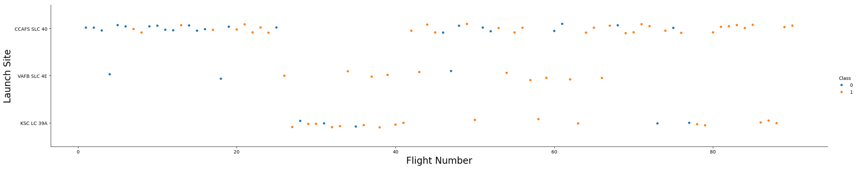
Flight Number vs. Launch Site
This scatter plot shows us more about where the rockets that failed were in place and time. The flight number is in order of launch so we can see the earliest launches are on the left. Those are also the launches with the highest failure rate.
We can also see that the most failures came from the most used site.
This shows that even if CCAFS SLC-40 has the highest failure rate, its probably not the site, but the nature of more launches and the rockets had a higher failure rate early on.

Slide 19
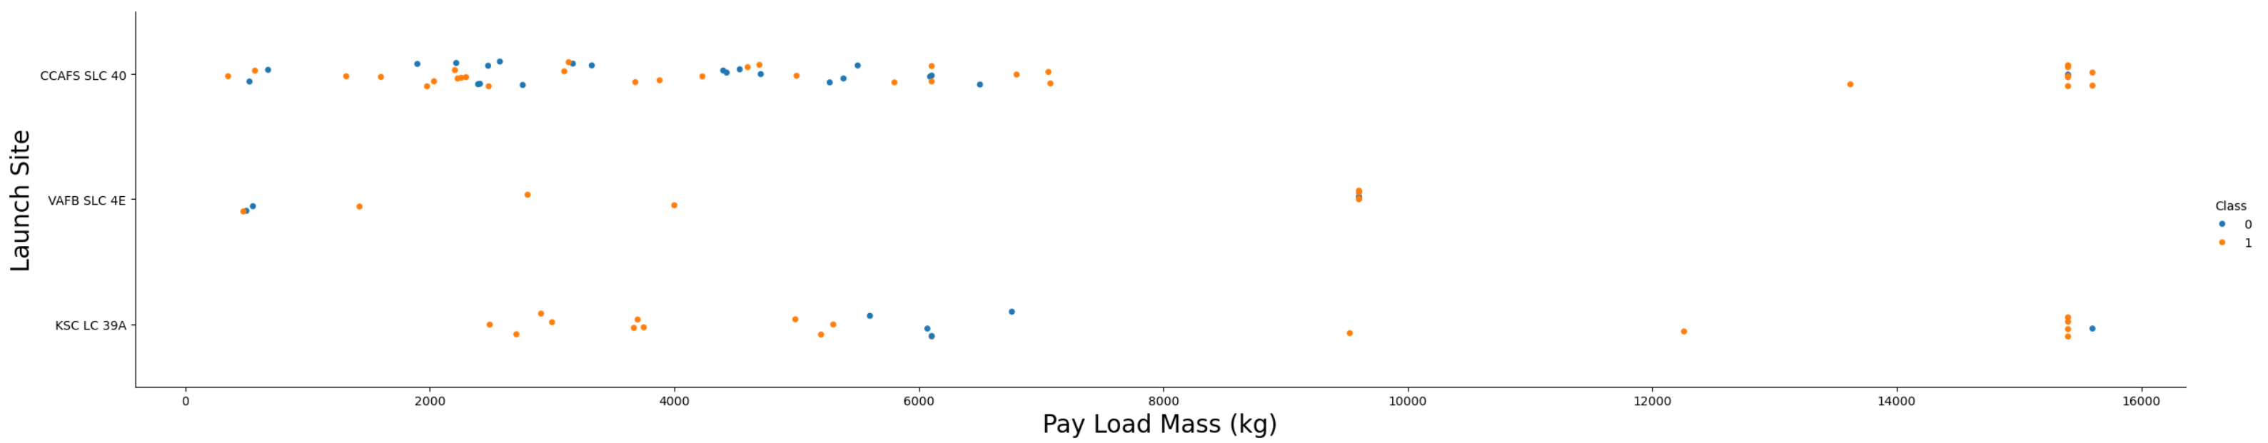
Payload vs. Launch Site
This scatter plot shows the relationship with the payload mass and the sites. We can see the failure of launches seems to group around the 4-6k kg range. This could be an important factor as it seems to happen regardless of launch site.

Slide 20
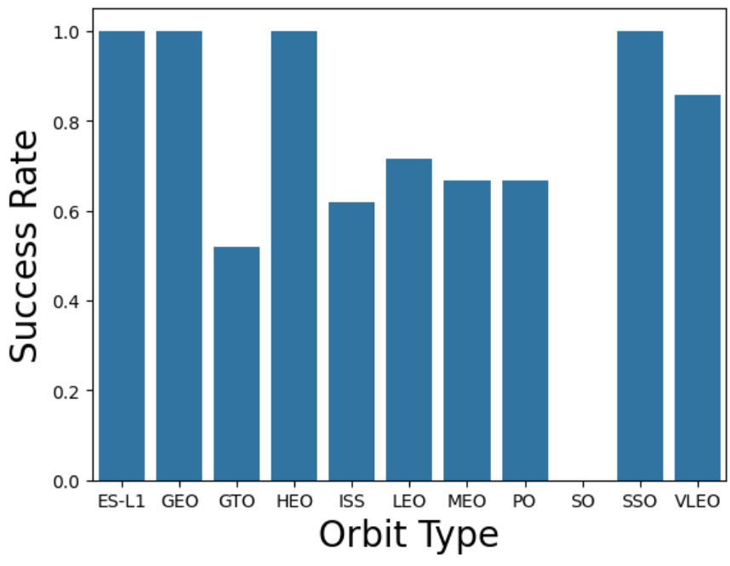
Success Rate vs. Orbit Type
This bar chart show the types of orbits and their success rate.
Different orbits will require different performance from the rocket, that might lead to failure from strain.
We can see that orbits “ES-L1”, “GEO”, “HEO”, and “SSO” have a 100% success rate.
Low Earth Orbit (LEO), Very Low Earth Orbits (VLEO), Geosynchronous Orbit (GTO), Sun-synchronous Orbit (SSO / SO), Lagrange Points (ES-L1), Highly Elliptical Orbit (HEO), International Space Station Orbit (ISS), Geocentric Orbits 2,000 km to 35,786 km (MEO), Circular Geosynchronous Orbit 35,786 km (GEO), Polar Orbit (PO)

Slide 21
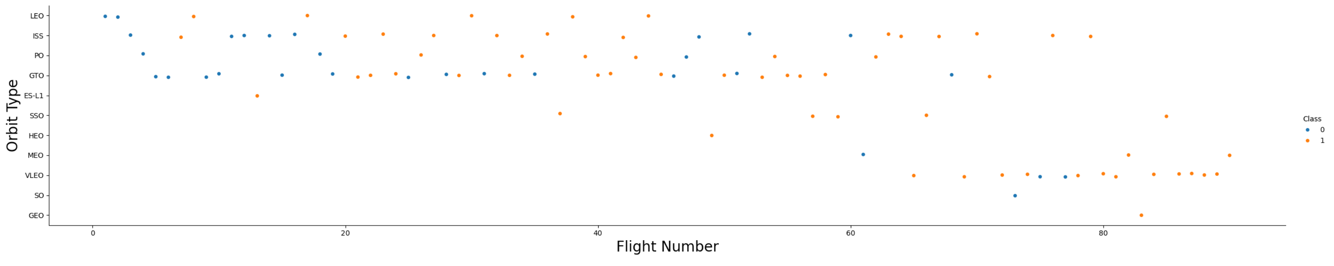
Flight Number vs. Orbit Type
This graph shows the success of the flight while comparing Orbit type to the flight number.
We see that the early launches are matched with mainly four types of orbits. These orbits are what we saw with a lower success rate in the previous slide. That can help account for the low success rate seen previously.

Slide 22
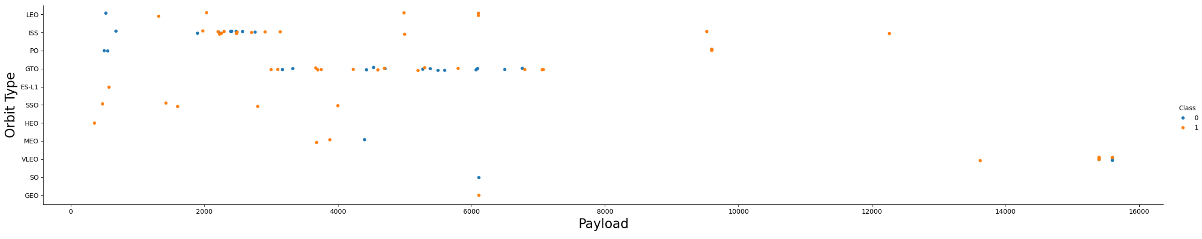
Payload vs. Orbit Type
This graph shows the success while comparing Payload vs Orbit type.
We can see what looks like a cluster of failures around the 6000 kg point. This might indicate that GTO orbits with that payload could be too much for the rockets to take.

Slide 23
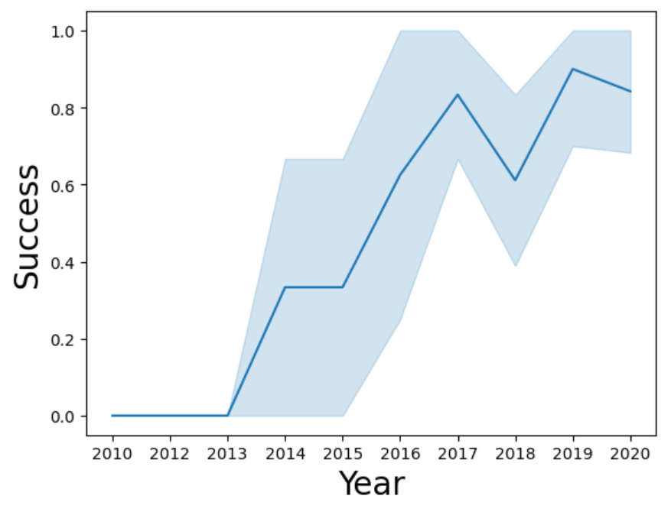
Launch Success Yearly Trend
This shows the trend line of the success for each year.
We see that around 2013 the success rate starts climbing. Except for 2018, and 2020 the success rate is going up.

Slide 24
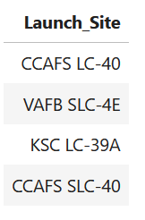
All Launch Site Names
We can query the names of the launch sites. By making use of the name of the launch site it allow us to group data to a physical location to give us the best comparison.

Slide 25
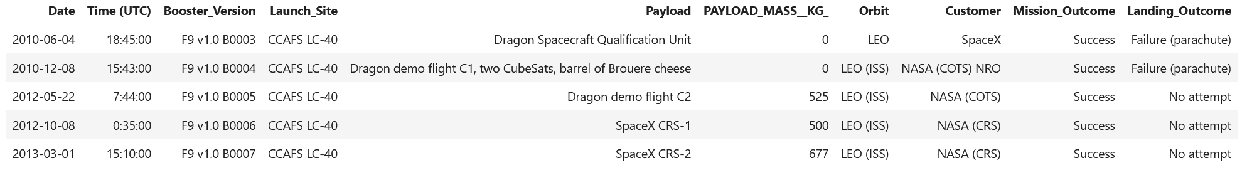
Launch Site Names Begin with 'CCA'
We can look at sites that start with the same code, that allows the comparison of launch pads that are relatively close and should have similar conditions.

Slide 26
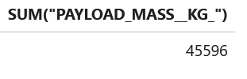
Total Payload Mass
We can sum up the payloads of launches from a specific customer
We can see here that NASA has launched 45,596 Kg with SpaceX

Slide 27
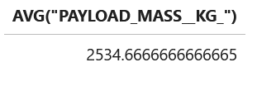
Average Payload Mass by F9 v1.1
We can query the average payload by the booster type F9 v1.1 which is 2534.6 kg.
This can be helpful in determining if this rocket type is carrying different loads.

Slide 28
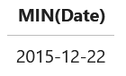
First Successful Ground Landing Date
We can query when the first landing data was. Allowing us to set landmark dates for better analysis when we see changes in success.

Slide 29
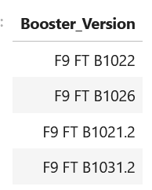
Successful Drone Ship Landing with Payload between 4000 and 6000
We queried what boosters carried 4-6 k kg payloads and landed on the drone ship. This can give us info on what rockets might have changes that improved landing success.

Slide 30
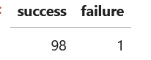
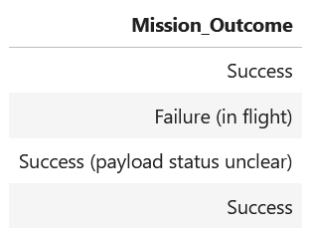
Total Number of Successful and Failure Mission Outcomes
The mission's outcomes are different then landing outcomes. If the payload reaches its intended orbit, then we have success regardless if the booster doesn’t land. We can query the success counting the different outcomes that indicate success.

Slide 31
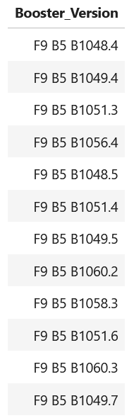
Boosters Carried Maximum Payload
Along with having info on boosters that carried payloads in a range, we can see what booster were maxed out. This is useful to see if newer versions are doing better or worse.

Slide 32
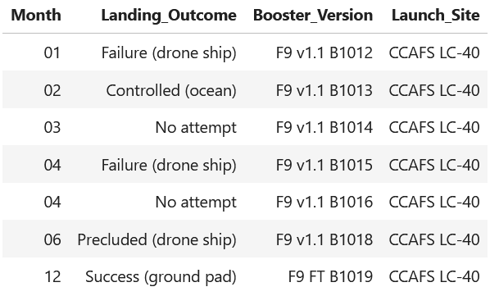
2015 Launch Records
This query allows us to focus on just one year. We want to look at the launches by month and see if there was a change through the year.

Slide 33
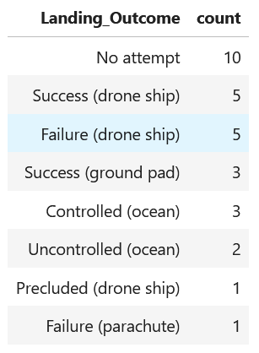
Rank Landing Outcomes Between 2010-06-04 and 2017-03-20
We also will want to look at a range of launches and see how the landing rank.
We can see in these ~7 years that there were several no attempts, but a decent number of successes.

Slide 34

Section 3

Slide 35
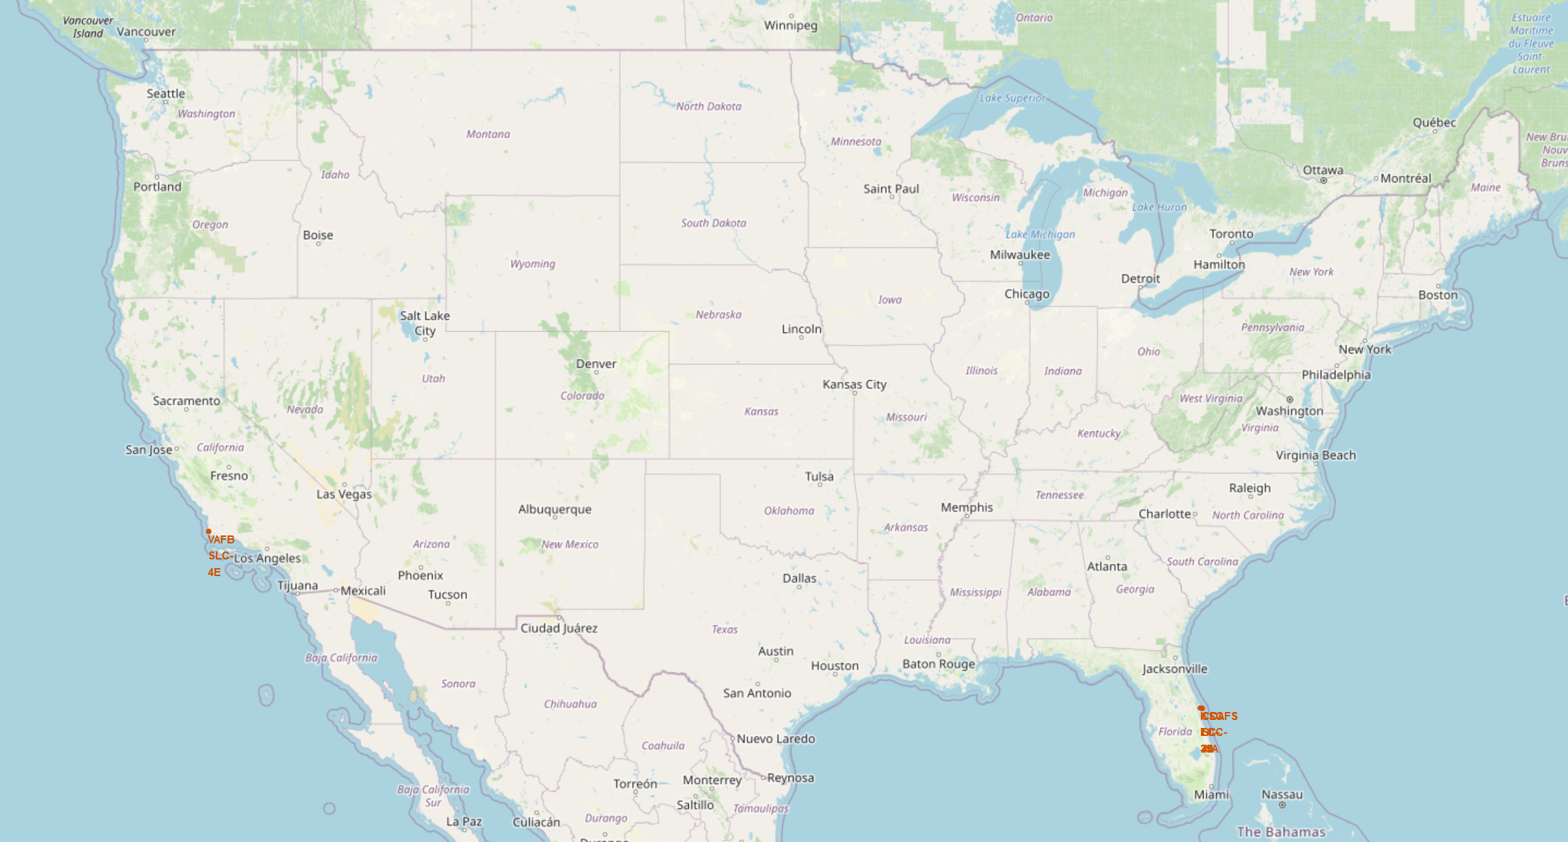
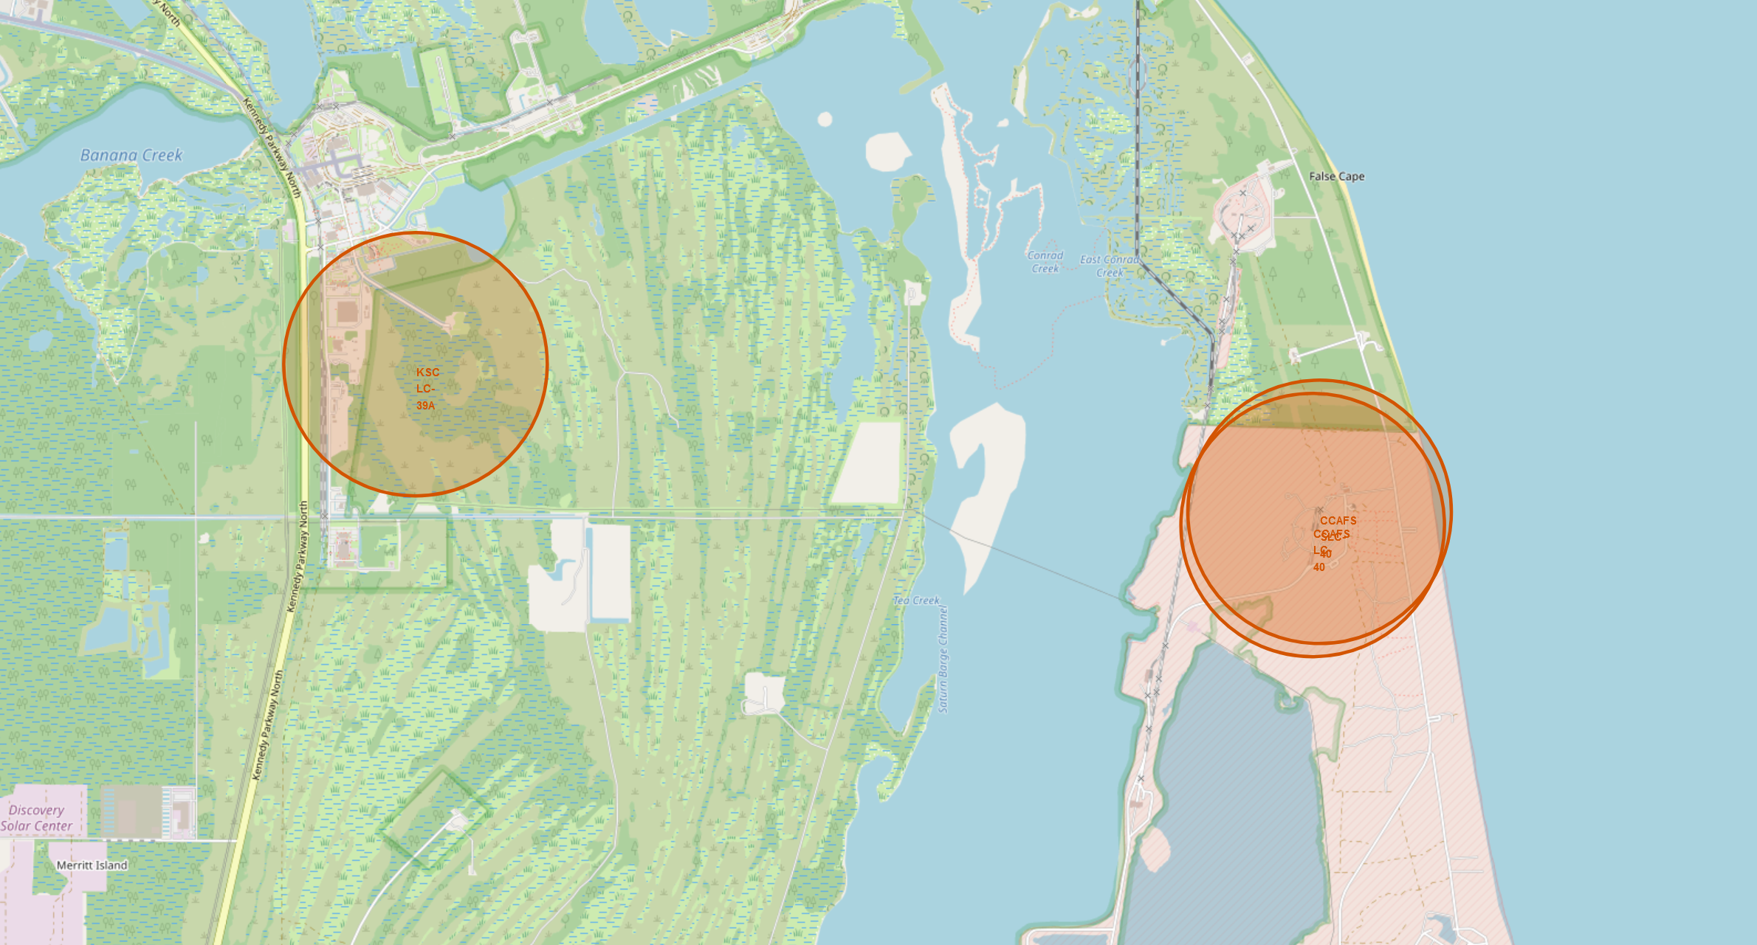
Locations of
SpaceX
Launch Sites
¾ of the launch sites are located within a few miles of each other on the east coast. This allows for analysis to be simplified as they have similar Weather and Environmental factors.
All the east coast launch sites are non-military sites. This might affect launch requirements.
The launch site at Vandenburg is the only site that allows for polar orbits. Polar orbits are different as they do not go with spin of the atmosphere and could experience different forces on the rocket.

Slide 36
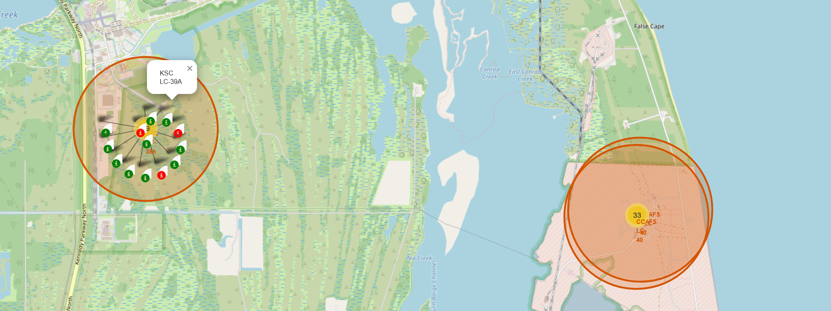
Launch Clusters with Success indicators
The Map is updated to show the location of launches and the success of the launch. Green indicating success and Red indicating a failure of some kind.
To have a clean map the launched are grouped into yellow circles showing the number of launches. Once clicked it reveals all the launches in a spiral pattern.
This allows for easier analysis at a glance to see where physical the most failures occurred.

Slide 37
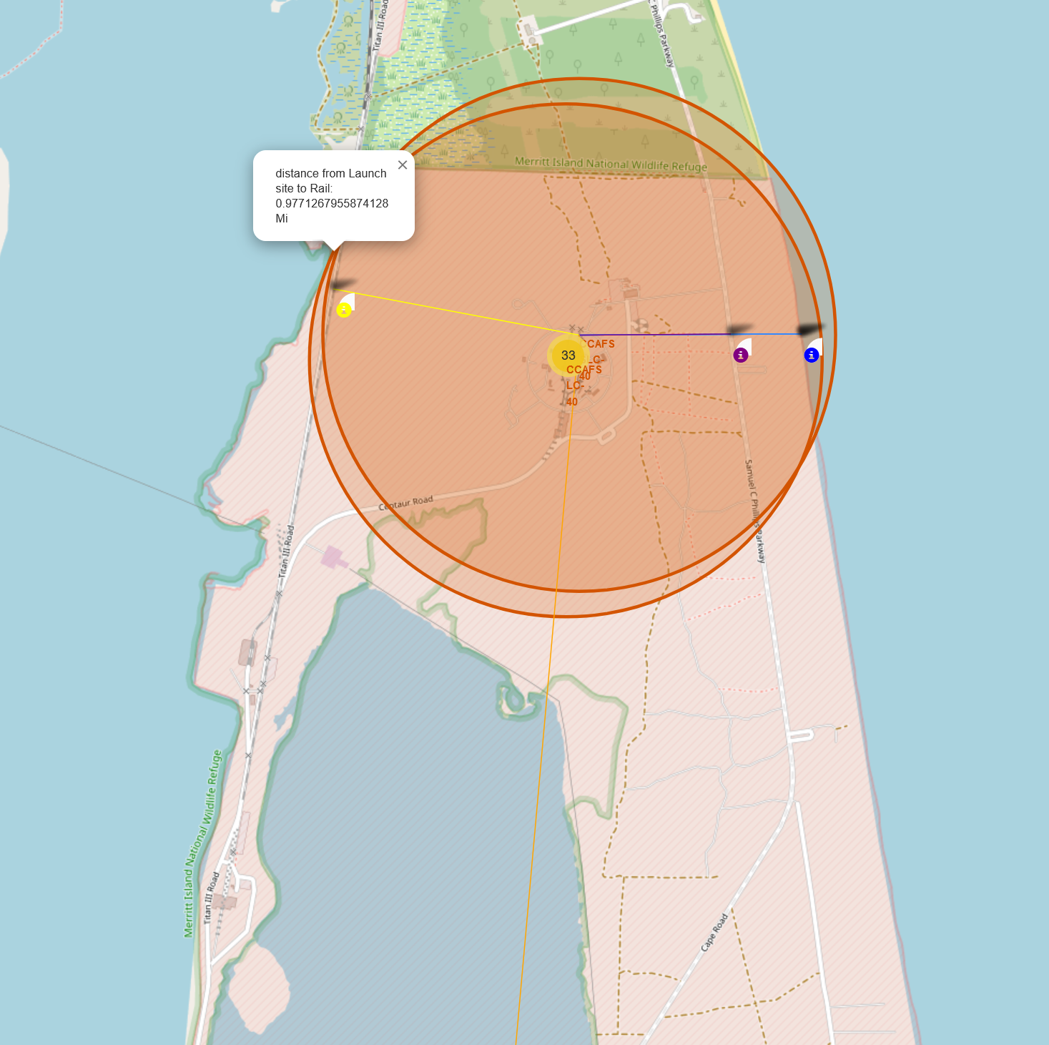
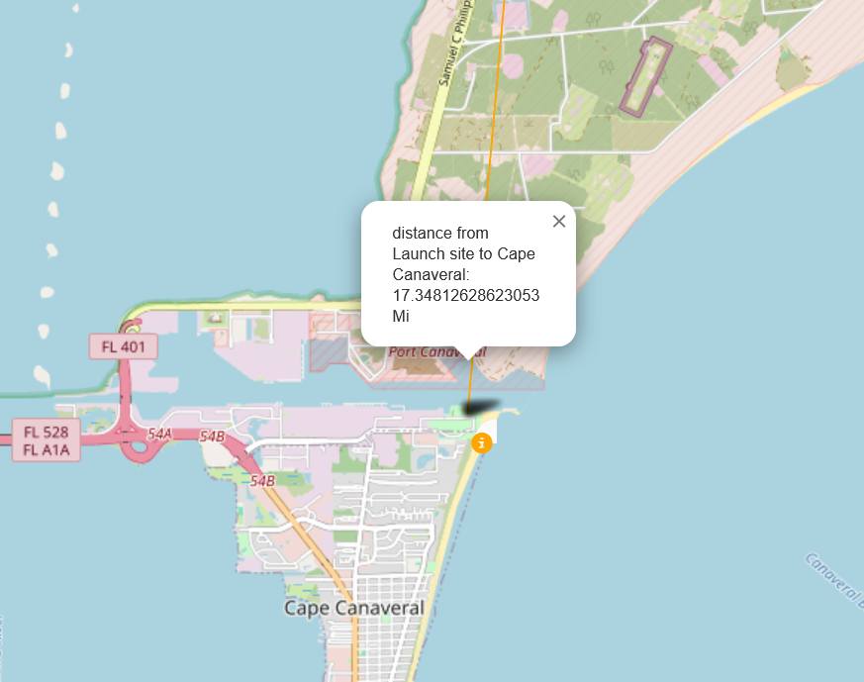
Distances to near by infrastructure
The location of near by buildings and infrastructure might play a role in the success of rockets. Roads or track could be damaged by rockets launches if too close. Passing traffic could endanger the rockets, that is why they are over half a mile to the closest highway or track
The nearest city is cape Canaveral which is over 17 miles away. The safety of the people is much greater as rockets when launching produce large pressure waves and sound, And much more so when they fail!

Slide 38

Section 4

Slide 39
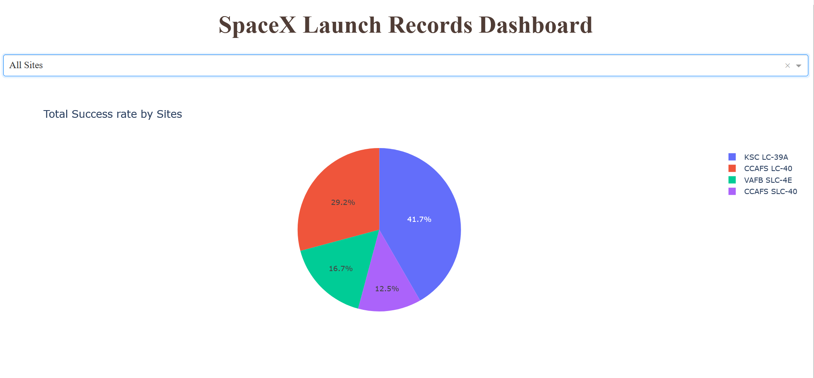
Dashboard – All sites pie chart
With the dashboard we can see the distributions of successful landings by launch sites.
This allows us to see the total number of successful landings from each site.
This data does not show how successful the site is as it doesn’t reflect the total number of launches out of each site. Just the successes of each site. For example, CCAFS LC-40 has the most launches of any site with 26 launches but only 7 Successful landings.

Slide 40
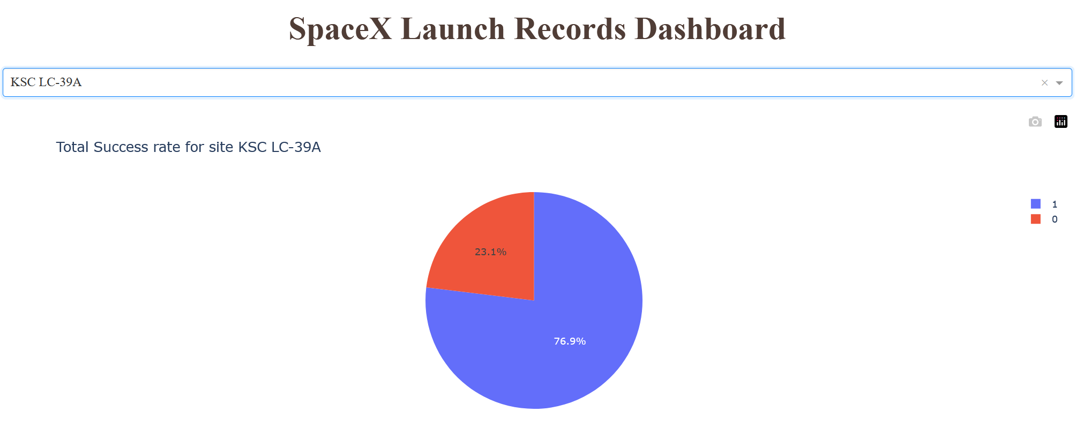
Dashboard – KSC LC-39A
By selecting a site from the dropdown, we can see the details about how successful all launches have been. For KSC LC-39A we see that the success rate is 76.9%
This part of the dashboard is designed to allow the inspection of each launch site. With its visualizations we can easily compare the different sites.

Slide 41
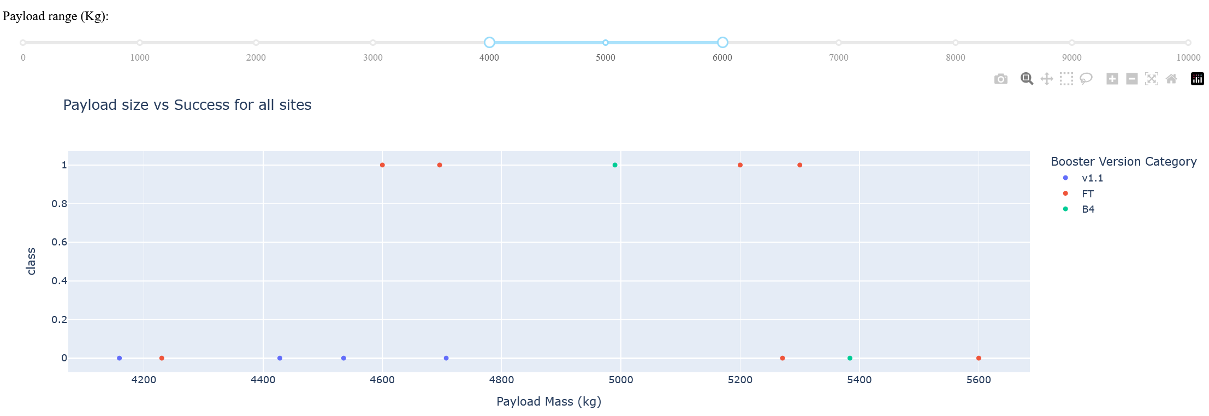
Dashboard – Payload Analysis
The Dashboard also includes a section to look at the launches by comparing the payload mass to the success while showing what booster version was being launched (show by dot color)
With the slider above the scatter plot we can set the payload limits. By setting the limits it will only show the payloads inside that range. This graph will also show the launches out of which pad is selected at the top of the page.
This will provide another useful way to compare launches by providing information about payload, booster version and success in an easy to digest manner.

Slide 42

Section 5

Slide 43
Classification Accuracy
Visualize the built model accuracy for all built classification models, in a bar chart
Find which model has the highest classification accuracy

Slide 44
Confusion Matrix
Show the confusion matrix of the best performing model with an explanation

Slide 45
Conclusions
Point 1
Point 2
Point 3
Point 4
…

Slide 46
Appendix
Include any relevant assets like Python code snippets, SQL queries, charts, Notebook outputs, or data sets that you may have created during this project

Slide 47


